Slide 1
Introduction to
Computational Modeling
Dr. David Bevan
Department of Biochemistry
Virginia Tech
MIEP Education Lead

Slide 2
MMI Objectives
Describe research and outcomes of MIEP
Develop computational models
Distinguish among modeling methods
Describe connection between experiment and modeling
Create environment to foster collaborations

Slide 3
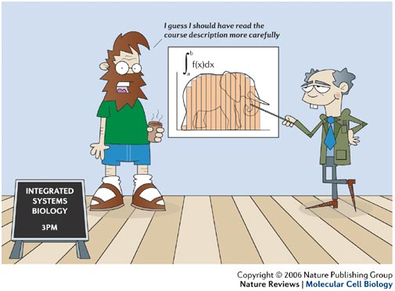
How Much Math Is Involved?
Wingreen and Botstein (2006) Nature Rev. Mol. Cell Biol. 7, 829–832.

Slide 4
Definitions
Bioinformatics: Research, development, or application of computational tools and approaches for expanding the use of biological, medical, behavioral or health data, including those to acquire, store, organize, archive, analyze, or visualize such data.
Computational Biology: The development and application of data-analytical and theoretical methods, mathematical modeling, and computational simulation techniques to the study of biological, behavioral, and social systems.

Slide 5
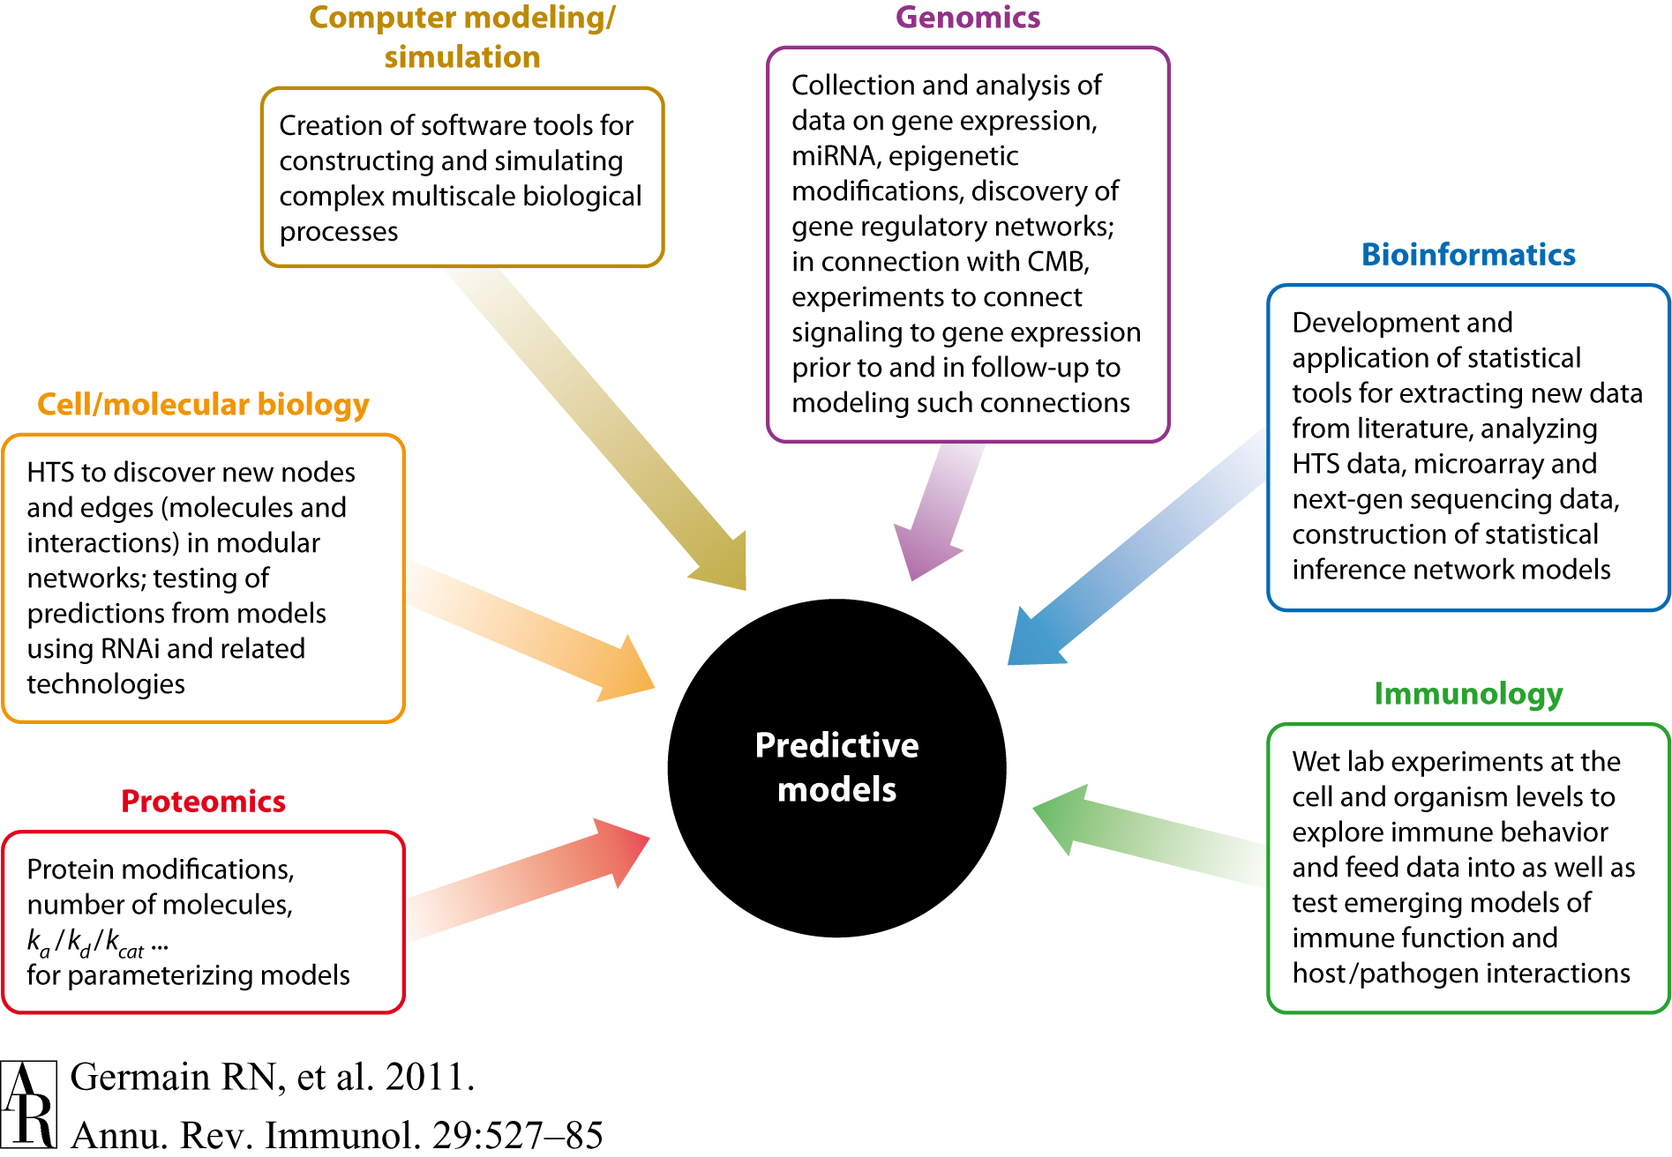
How it All Fits Together

Slide 6
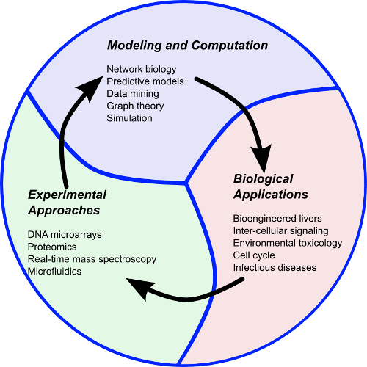
Systems Biology
Quantitative methods of mathematical analysis and modeling to investigate dynamical performance
Comprehensive analysis of interactions between components of systems over time
“By discovering how function arises in dynamic interactions, systems biology addresses the missing links between molecules and physiology.”
Bruggeman and Westerhoff (2007) Trends Microbiol.
15: 45-50.
Immunology
http://www.isbet.ictas.vt.edu

Slide 7
Why Now?
Not a new approach
Compare to reductionist approach
High-throughput, quantitative, large-scale experimental approaches have renewed interest and increased capabilities
Challenge is to transform molecular knowledge into understanding of complex phenomena in cells, tissues, organs, and organisms

Slide 8
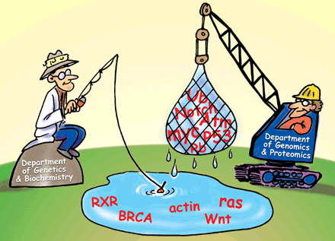
Old School vs New School
Life science disciplines in the 21st century are being transformed from purely lab-based sciences to include information science as well.
J. Sutliff, Science 291, 1221 (2001)

Slide 9
What is Systems Biology?
Understanding structure of system, such as gene regulatory and biochemical networks
Understanding the dynamics of system and constructing model with prediction capability
Understanding control methods of system
Understanding design methods of system (i.e., based on design principles, not trial-and-error)

Slide 10
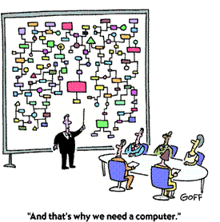
One View of Systems Biology

Slide 11
Essential Features
System is not just an assembly of genes and proteins => properties cannot be understood merely by drawing diagrams of interconnections
Diagram is first step, analogous to static roadmap
Really interested in traffic patterns and how to control them
Need to know dynamic interactions

Slide 12
What is a Model?
Abstract representation of a real system in mathematical terms
  Cannot include all details of system
  Can capture essential mechanism of system
Realism captured when entities in model correspond to real components and rules governing model correspond to real laws
Should give integrated description of components at various scales

Slide 13
Why Generate Models?
Represent existing knowledge of biological system
Identify missing components in a pathway
Determine most critical components of a pathway
Test and refine hypotheses for future wet-lab experimentation
Predict behavior of system given any perturbation
Redesign or perturb networks to observe emergence of new properties

Slide 14
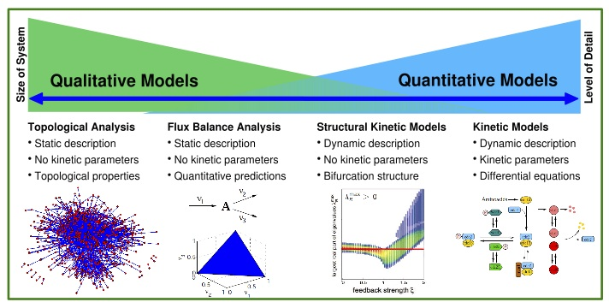
Types of Models
Steuer, R. (2008) Adv Chem Phys, 105-251.

Slide 15
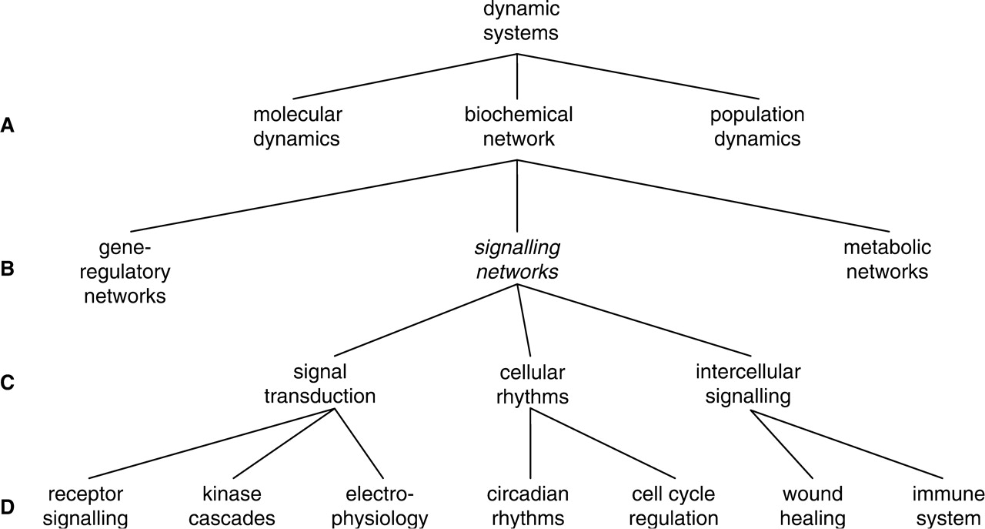
Dynamic Models in Biology
Gilbert D et al. Brief Bioinform 2006;7:339-353

Slide 16
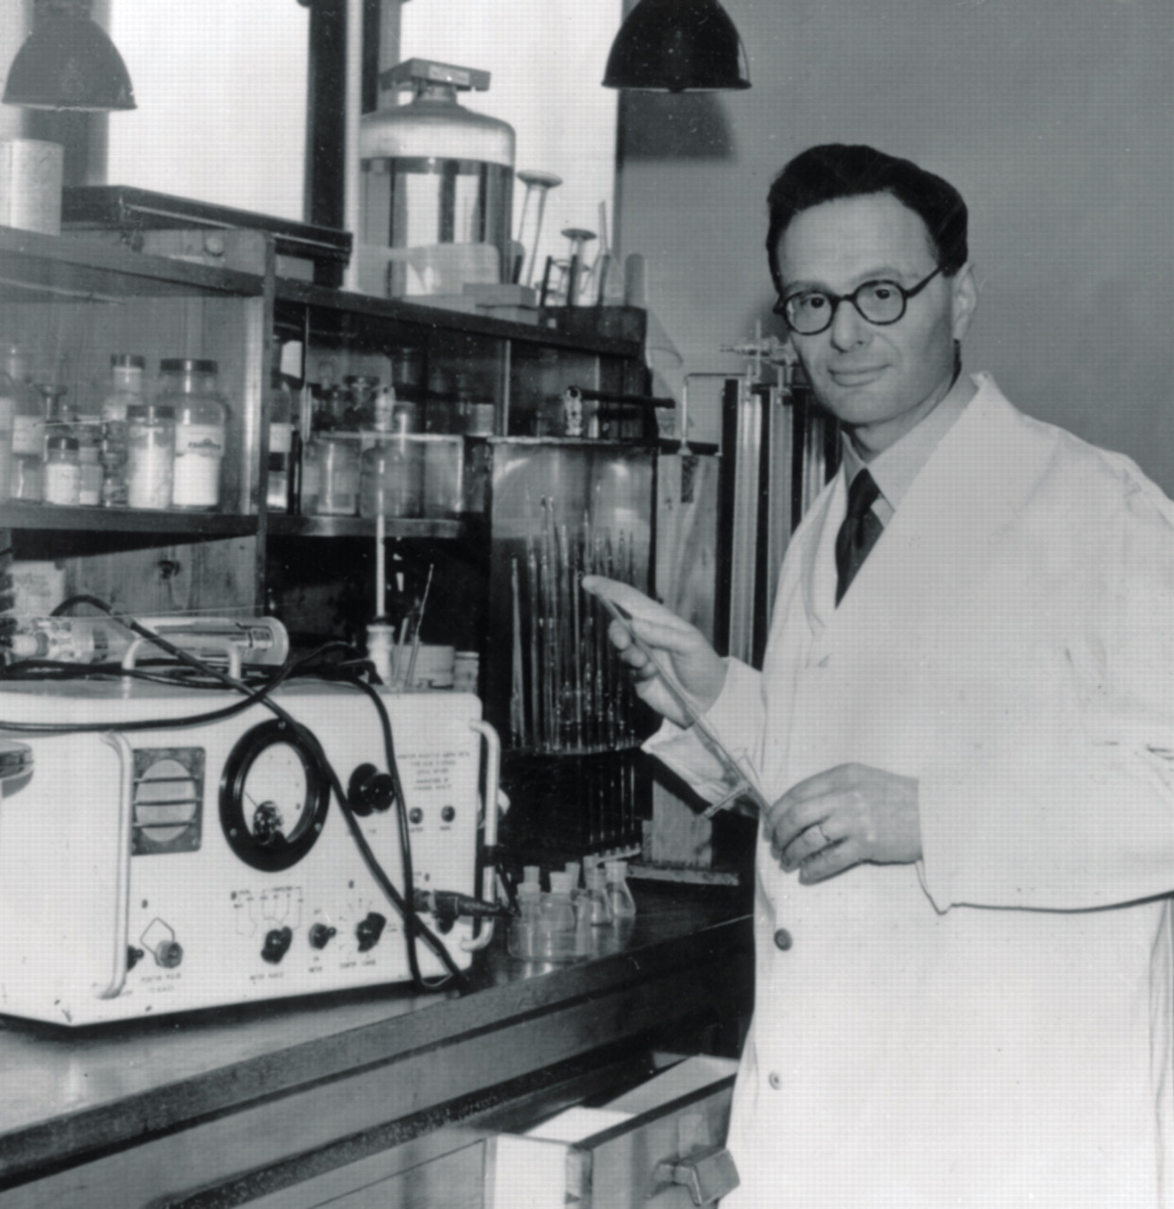
Heyday of Metabolism Research
1920’s to 1950’s
Several Nobel prizes
Steven McKnight, “The more sticky problems that required attention to the dynamics of metabolism and that were pushed aside for decades now loom as interesting and important challenges” (Science 330, 1338–1339, 2010).
Hans Krebs, Nobel Prize, 1953.

Slide 17
Modeling Representations
Michaelis-Menten approximation
Mass-action kinetics
Conventional Notation
Possible ODE representation
Gilbert D et al. Brief Bioinform 2006;7:339-353

Slide 18
COPASI
COmplex PAthway SImulator
Stand-alone program with graphical (CopasiUI) and command line versions (CopasiSE)
Major functions
  Models
  Tasks
  MultipleTasks
  Output
  Functions

Slide 19
Standard Methods
Deterministic simulation (integration of ODEs)
Stochastic simulation (e.g., Gillespie’s algorithm)
Computation of steady states and their stability
Stoichiometric network analysis
Sensitivity analysis (metabolic control analysis)
Optimization
Parameter estimation
COPASI provides all standard methods and some unique ones for simulation and analysis of biochemical networks
COPASI supports use by non-experts
COPASI has functionality to convert rate constants to probabilities (for stochastic simulation)

Slide 20
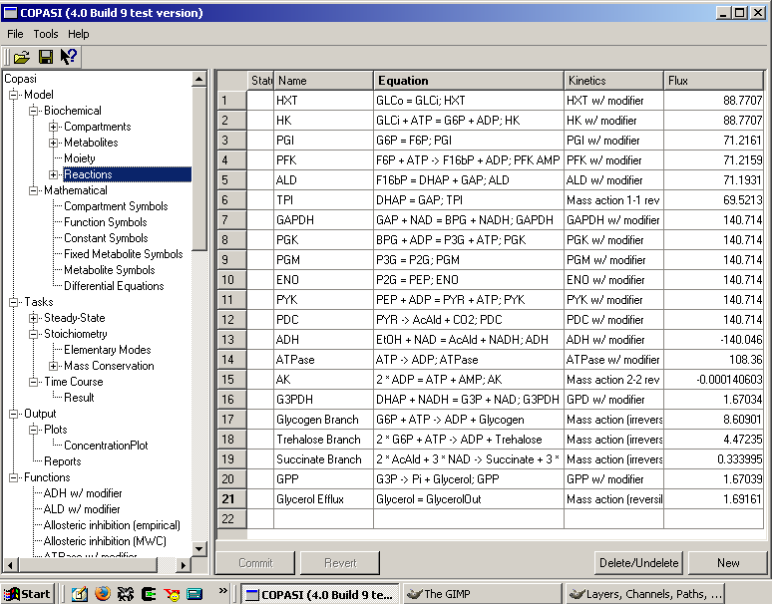
COPASI Metabolites

Slide 21
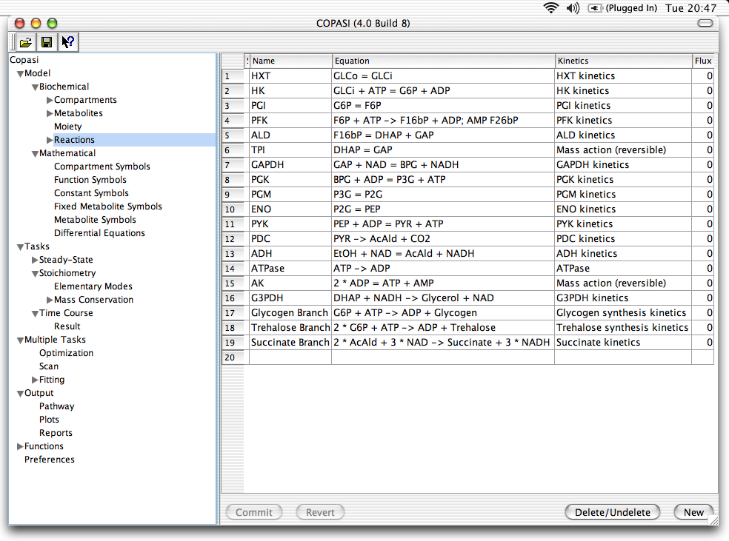
COPASI Reactions

Slide 22
Modeling Tools at sbml.org
262 packages as of June 4, 2014

Slide 23
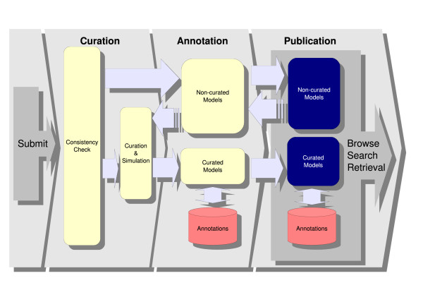
Biomodels Database
http://www.ebi.ac.uk/biomodels-main/
Repository of peer-reviewed, published computational models
  530 curated
  655 non-curated
Li, C. (2010) BMC Systems Biology 4: 92.

Slide 24
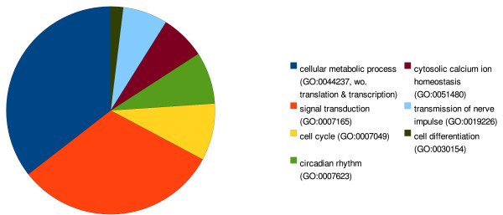
Types of Models in Biomodels
Li, C. (2010) BMC Systems Biology 4: 92.

Slide 25
Formalisms for Modeling
A way to represent a model to allow simulation: operating a model under a configuration of interest to observe behavior
Considerations for selecting a formalism
  Objective of the study
  Scale of the model
  Size of the model
  Nature of available data
  Availability of software tools

Slide 26
Frameworks for Modeling
Static | Dynamic
Connections but no representation of time | Incorporation of time
Continuous | Discrete
Variables change continuously (age of individual) | Variables have discrete values (number of immune cells that die with age)
Deterministic | Stochastic
No probabilistic components | Includes randomness
Uniform biochemical environments | Fewer molecules available to participate
Output determined by parameter values and initial conditions | Ensemble of different outputs
Simpler, faster to compute
Equation-based | Agent-based
Model is set of equations | Model is set of agents that encapsulate behaviors of individuals

Slide 27
Scales for Formalisms
 | Deterministic differential equations | Stochastic differential equations | Agent-based modeling
Molecule
Genes & Proteins
Cell
Tissue
Organ
Organism
Adapted from Narang et al (2012) Immunol Res 53: 251-265.

Slide 28
Agent-Based Modeling
What is an agent?
  A discrete entity with its own goals and behaviors
  Autonomous, with capability to adapt and modify its behaviors
Assumptions
  Some key aspect of behaviors can be described
  Mechanisms by which agents act can be described
  System cans be built “from the bottom up”
Examples
  People, groups, organizations
  Social insects, swarms
  Heterogeneous cellular systems

Slide 29
When to use ABM
When there is a natural representation as agents
When there are decisions and behaviors that can be defined discretely
When it is important that agents adapt and change their behavior
When it is important that agents have a dynamic relationships with other agents, and agent relationships form and dissolve
When it is important that agents have a spatial component to their behaviors and interactions

Slide 30
Advantages of ABMs for Biomedical Research
Intuitive
Work well in three dimensions
Can reproduce complex behaviors with a few simple rules
Interactions between individual agents can result in emergence of structures and function
Can be hybridized with ODE methods

Slide 31
ENISI
ENteric Immunity SImulator
For in silico study of gut immunopathologies
Tool for identifying treatment strategies that reduce inflammation-induced damage
ENISI Visual provides visualization and control of simulations
Cells represented by icons that change color as state changes
Mei et al (2012) IEEE International Conference on Bioinformatics and Biomedicine

Slide 32
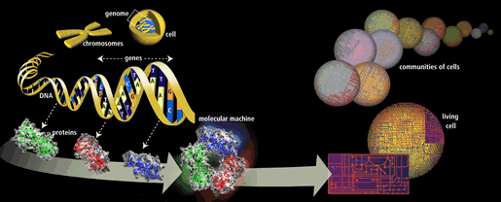
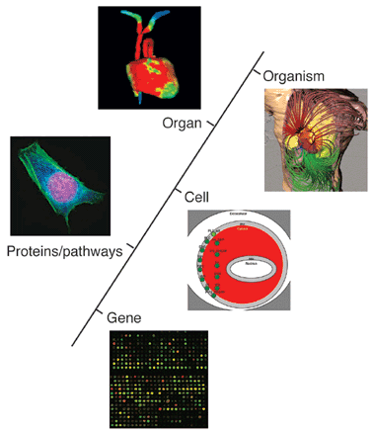
Multidimensional Biology
Pennisi, E. (2003) Science 302: 1646-1649.

Slide 33
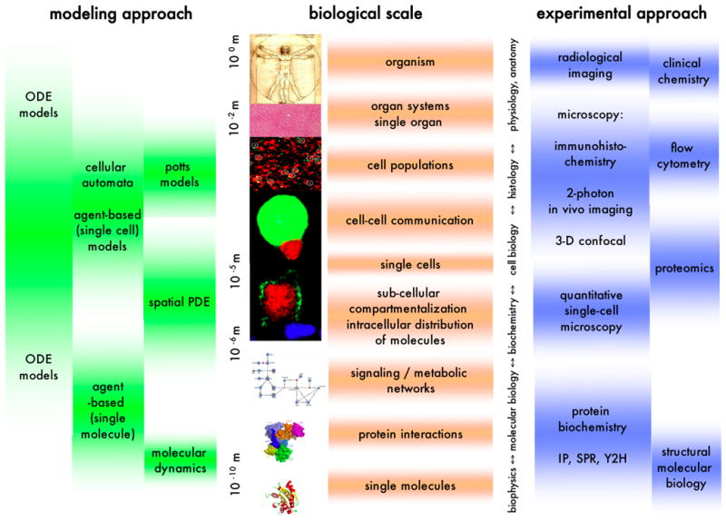
Multiscale Modeling
Meier-Schellersheim et al (2009) Interdiscip Rev Syst Biol Med 1: 4-14.

Slide 34
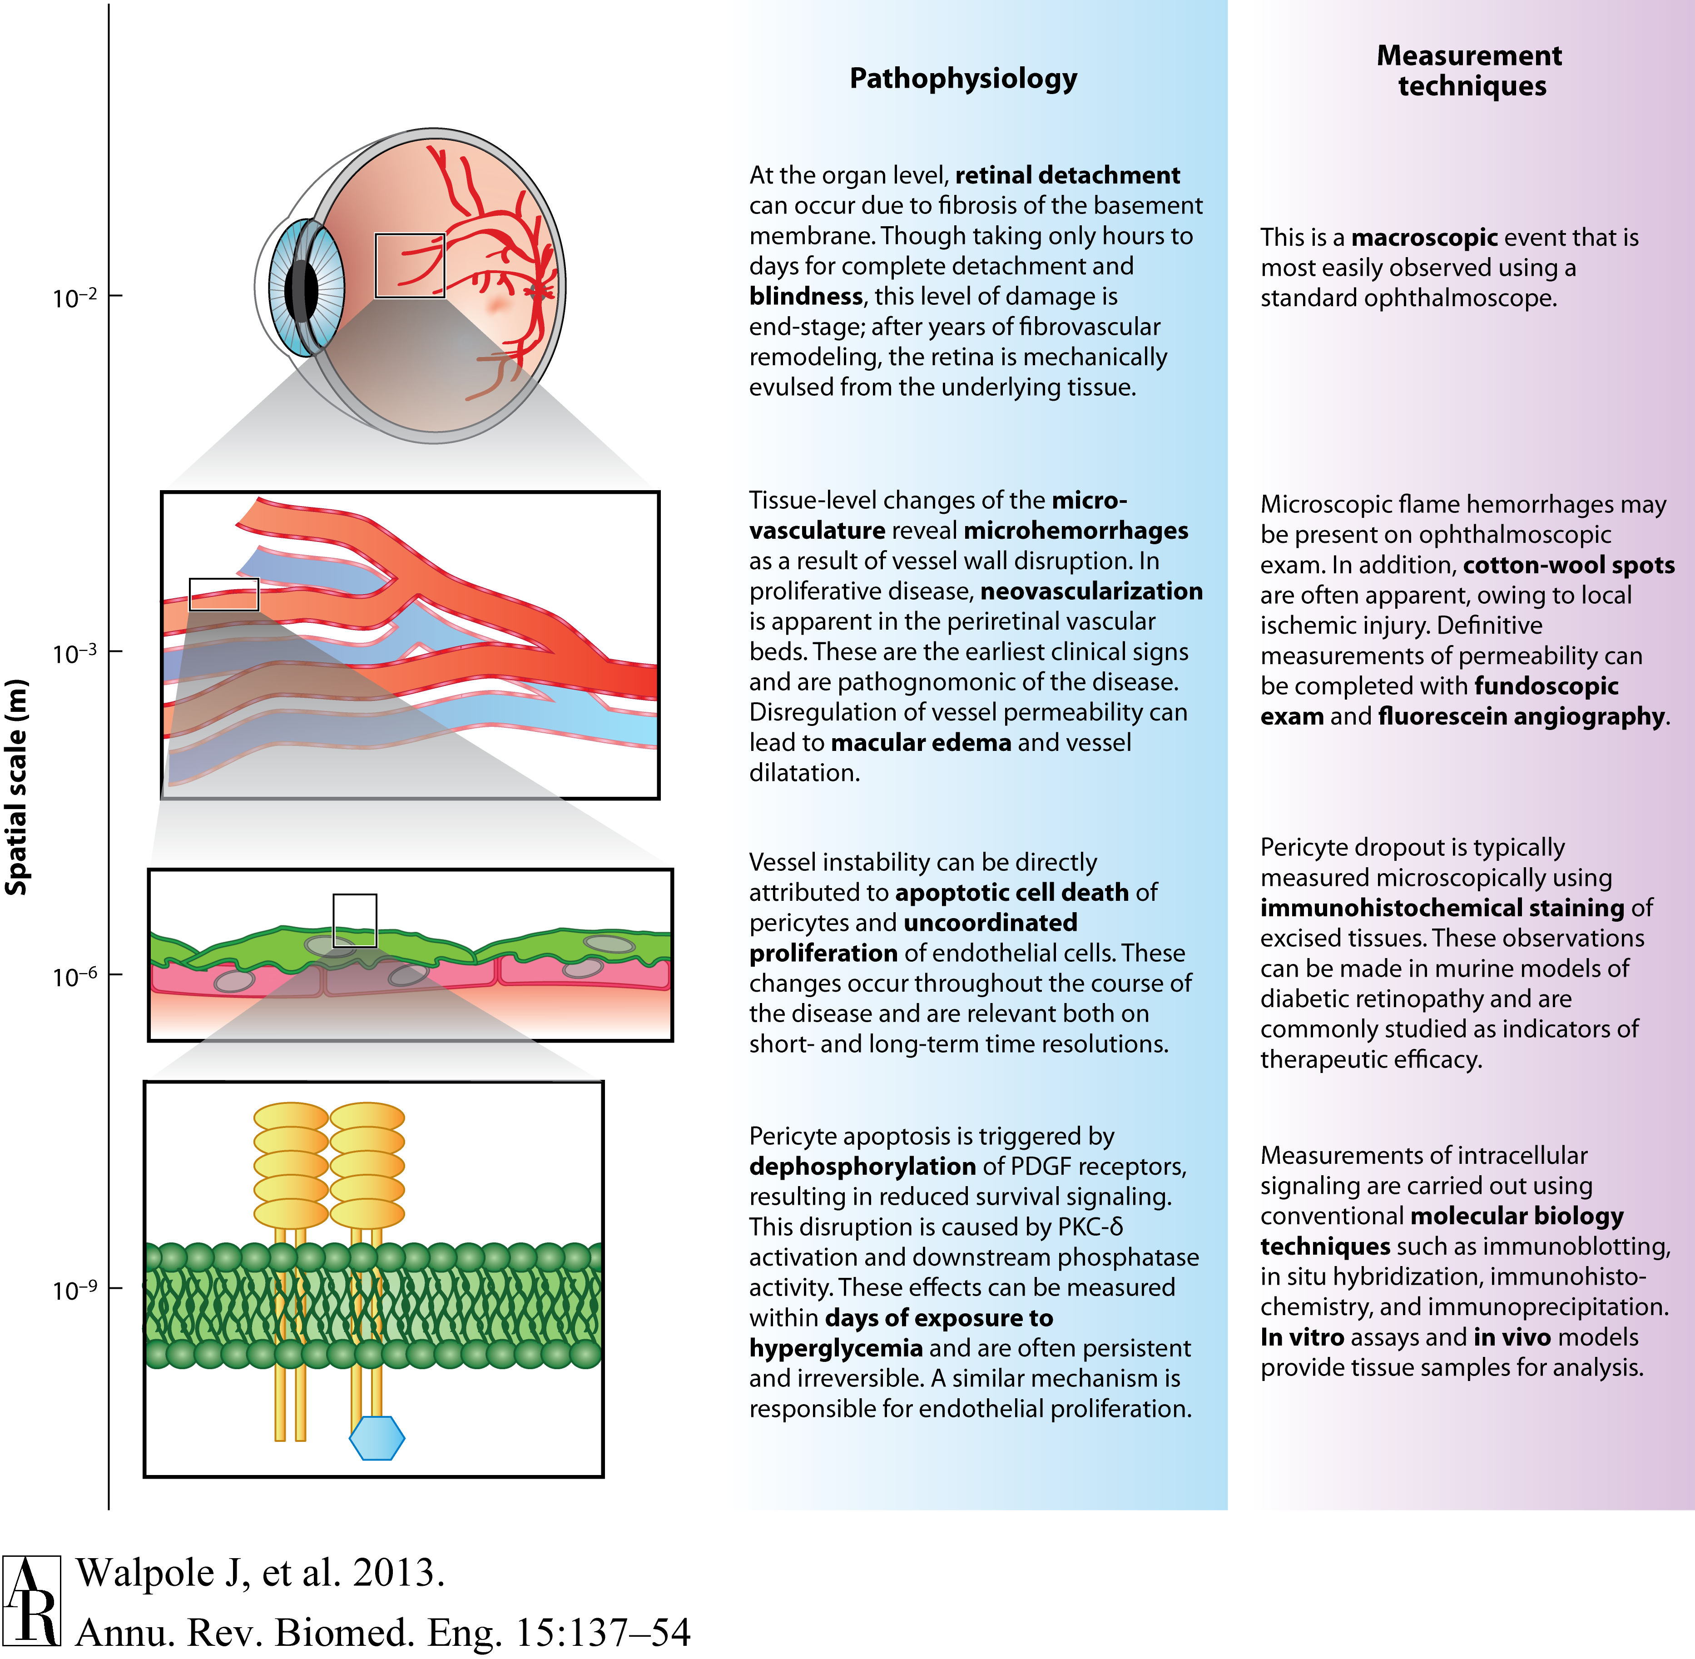
Multiscale Pathophysiology

