Slide 1
CD4+ T cell differentiation:
An experimental view
Ken J. Oestreich, Ph.D.
Assistant Professor, VTCRI
Assistant Professor, Dept. of Biomedical Sciences
and Pathobiology, Virginia Tech

Slide 2
Expanding view of specialized CD4⁺ T cell subtypes
Basics and historical perspective
Stable versus flexible T helper cell types
Mechanisms that regulate differentiation decisions
Computational modeling as a valuable tool

Slide 3
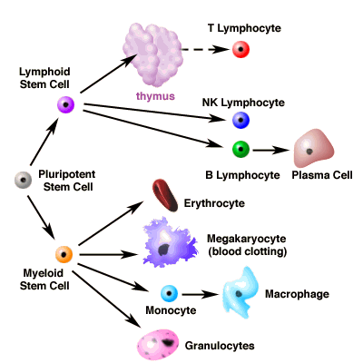
Development in the Immune System
CD4⁺ T helper cells
or
CD8⁺ Cytotoxic cells

Slide 4
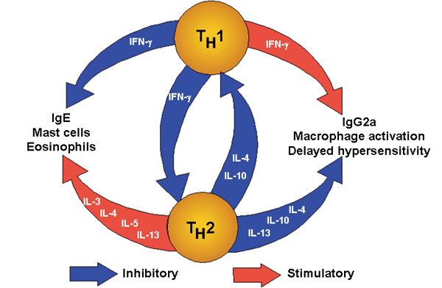
Original Helper T cell model
Extracellular pathogens
Intracellular pathogens
Mosmann and Coffman model 1986
Identification of two T helper cell subtypes
Unique immune functions
Antagonistic to each other’s function
Historical perspective:
RL Coffman. 2006. Nat. Immunol. 7: 539-541.

Slide 5
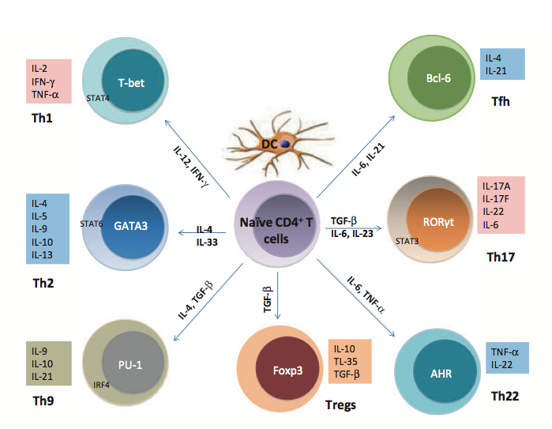
T helper cell differentiation
1986-2003
Adapted from Liu et al. Immunol Rev 2013

Slide 6
T helper cell differentiation
Present day
Adapted from Liu et al. Immunol Rev 2013

Slide 7
T helper 1 (Th1) cells
Role in immune response
Immune response against intracellular pathogens
(viruses, bacteria-i.e. mycobacterium, salmonella)
Effector function
Secretion of Interferon Gamma
Recruitment of CD8⁺ T cells, activate macrophages,
promote B cell class switching

Slide 8
T helper 2 (Th2) cells
Role in immune response
Control of extracellular parasites (helminths)
Effector function
Secretion of IL-4, IL-5, IL-13 (mucosal barrier)
Recruitment of eosinophils

Slide 9
T helper 17 (Th17) cells
Role in immune response
Response against extracellular bacteria and fungi-
Staphylococcus aureus, Klebsiella pneumonia
(can promote inflammation/autoimmune disease)
Effector function
Secretion of IL-17
Recruitment of neutrophils

Slide 10
T follicular helper (Tfh) cells
Role in immune response
Promote antibody-mediated immune response
through interactions with B cells
Effector function
Secretion of IL-21, B cell crosstalk in germinal centers

Slide 11
T regulatory (Treg) cells
Role in immune response
Suppress effector T cell responses
(limit potential autoimmune disease)
Effector function
Consume IL-2, Secrete anti-inflammatory IL-10, TGF-β

Slide 12
T helper cell differentiation
Adapted from Liu et al. Immunol Rev 2013

Slide 13
Reasons for expecting there may be flexibility
(co-expression of lineage-defining factors)
T-bet and Gata3 co-expression
-Hwang, E. S., Szabo, S. J., Schwartzberg, P. L. & ^{Glimcher, L. H.}
^{Science 307, 430–433 (2005).}
-Hegazy, A. N. et al. Immunity 32, 116–128 (2010).
T-bet and Bcl-6 co-expression
-Nakayamada, S. et al. Immunity 35, 919–931 (2011).
-Pepper, M., Pagan, A. J., Igyarto, B. Z., Taylor, J. J. & Jenkins, M. K.
^{Immunity 35, 583–595 (2011).}
-Oestreich, K. J., Huang, A. C. & Weinmann, A. S. J. Exp. Med. 208, 1001–1013 (2011).
-Oestreich, K. J., Mohn, S. E. & Weinmann, A. S. Nature Immunol. 13, 405–411 (2012).
-Lu, K. T. et al. Immunity 35, 622–632 (2011).
FoxP3 and T-bet/Gata3/Bcl-6/Rorγt co-expression
-Linterman, M. A. et al. Nature Med. 17, 975–982 (2011).
-Chung, Y. et al. Nature Med. 17, 983–988 (2011).
^{-Chaudhry, A. et al. Science} ^{326, 986–991 (2009).}
^{-Oldenhove, G. et al.} ^{Immunity 31, 772–786 (2009).}
-Osorio, F. et al. Eur. J. Immunol. 38, 3274–3281 (2008).
-Wang, Y., Su, M. A. & Wan, Y. Y. Immunity 35, 337–348 (2011).
-Zhang, F., Meng, G. & Strober, W. Nature Immunol. 9, 1297–1306 (2008).
-Zhou, L. et al. Nature 453, 236–240 (2008).

Slide 14
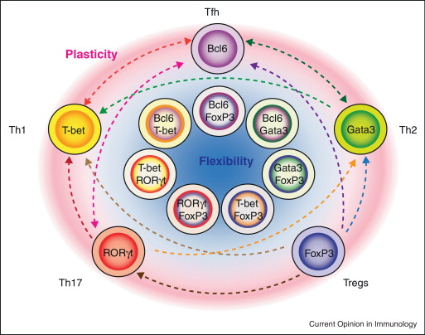
Specialized CD4⁺ T cell subtype flexibility
Current Opinion in Immunology Volume 24, Issue 3 2012 297 - 302

Slide 15
How can co-expression of factors be explained?
What are the functional outcomes of
co-expression?

Slide 16
How can co-expression of factors be explained?
What are the functional outcomes of
co-expression?

Slide 17
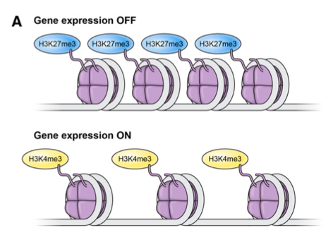
Defining the stability versus flexibility of
specialized CD4⁺ T cell subtypes
Epigenetic insights
Muranski et al. Blood , 2013.

Slide 18
Defining the stability versus flexibility of
specialized CD4⁺ T cell subtypes
Epigenetic insights
What is the epigenetic status of lineage-defining factor loci?

Slide 19
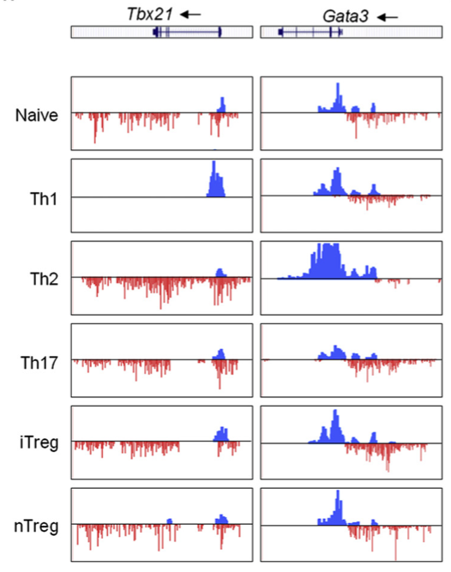
Defining the stability versus flexibility of
specialized CD4⁺ T cell subtypes
Epigenetic insights-Bivalent Chromatin State
T-bet (Th1)
Gata3 (Th2)
H3K4me3 (Active)
H3K27me3 (Repressed)
Cell Type
Wei et al. Immunity, 2009.

Slide 20
Defining the stability versus flexibility of
specialized CD4⁺ T cell subtypes
Epigenetic insights-Bivalent Chromatin State
T-bet (Th1)
Gata3 (Th2)
H3K4me3 (Active)
H3K27me3 (Repressed)
Cell Type
Wei et al. Immunity, 2009.

Slide 21
Defining the stability versus flexibility of
specialized CD4⁺ T cell subtypes
Epigenetic insights-Bivalent Chromatin State
T-bet (Th1)
Gata3 (Th2)
H3K4me3 (Active)
H3K27me3 (Repressed)
Cell Type
Wei et al. Immunity, 2009.

Slide 22
Defining the stability versus flexibility of
specialized CD4⁺ T cell subtypes
Epigenetic insights-Bivalent Chromatin State
T-bet (Th1)
Gata3 (Th2)
H3K4me3 (Active)
H3K27me3 (Repressed)
Cell Type
Wei et al. Immunity, 2009.

Slide 23
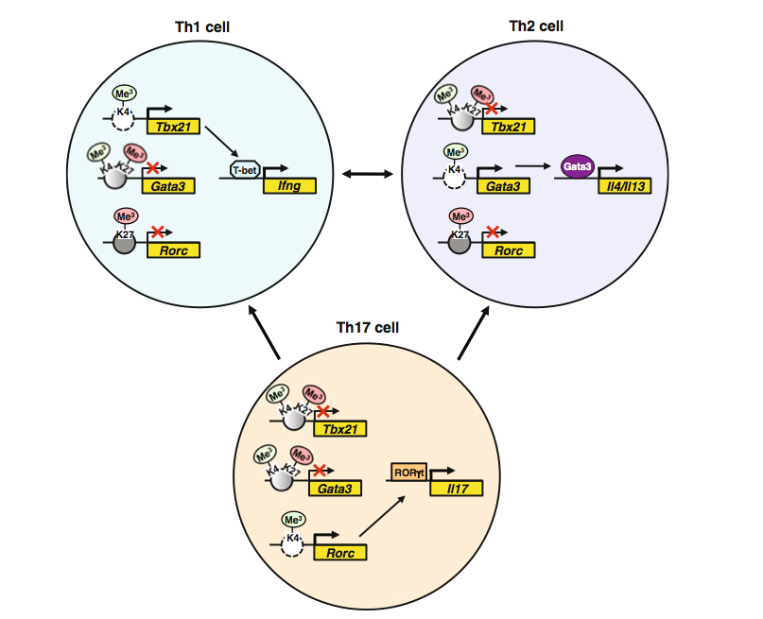
Defining the stability versus flexibility of
specialized CD4⁺ T cell subtypes
Uni-directional Plasticity
Oestreich et al. Curr Top Microbiol Immunol , 2013.

Slide 24
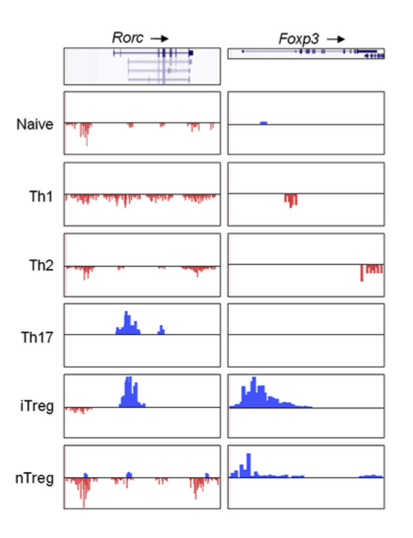
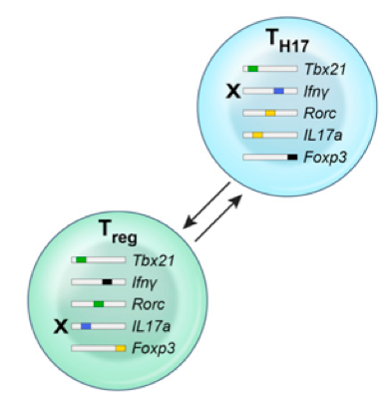
Defining the stability versus flexibility of
specialized CD4⁺ T cell subtypes
Epigenetic insights-Bivalent Chromatin State
Rorγt (Th17)
Foxp3 (Treg)
Cell Type
H3K4me3 (Active)
Wei et al. Immunity, 2009.
H3K27me3 (Repressed)

Slide 25
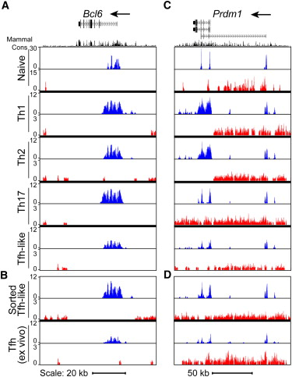
Epigenetic patterns of transcription factor
genes in CD4⁺ T cell subtypes
Bcl6 (Tfh)
H3K4me3
H3K27me3
Lu et al. Immunity 35, 2011.

Slide 26
Epigenetic patterns of transcription factor
genes in CD4⁺ T cell subtypes
Bcl6 (Tfh)
H3K4me3
H3K27me3
Lu et al. Immunity 35, 2011.

Slide 27
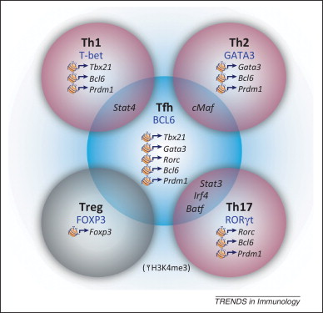
Defining the stability versus flexibility of
specialized CD4⁺ T cell subtypes
Multi-directional Plasticity
Cannons et al. Trends in Immunology , 2013.

Slide 28
How can co-expression of factors be explained?
At the epigenetic level, lineage-defining factors maintain the
capacity to be expressed in multiple T helper cell subsets.
What are the functional outcomes of
co-expression?

Slide 29
How can co-expression of factors be explained?
At the epigenetic level, lineage-defining factors maintain the
capacity to be expressed in multiple T helper cell subsets.
What are the functional outcomes of
co-expression?

Slide 30
Interplay between lineage-specifying transcription factors
Bi-directional competition
Gata3
T-bet
Early fate decision-
one factor “wins” over another (Th1 cell)
IL-4,IL-5, IL-13
Hwang et al. Science. 2005

Slide 31
Interplay between lineage-specifying transcription factors
Bi-directional competition
Gata3
T-bet
Early fate decision-
one factor “wins” over another (Th1 cell)
IL-4,IL-5, IL-13
Hwang et al. Science. 2005
Co-dominant competition
Gata3
Bcl6
IL-4,IL-5, IL-13
Factors cooperate to establish
a hybrid T helper lineage(Th2+1 cell)
T-bet
Bcl6
Ifng
Hegazy et al. Immunity. 2010

Slide 32
Interplay between lineage-specifying transcription factors
Bi-directional competition
Gata3
T-bet
Early fate decision-
one factor “wins” over another (Th1 cell)
IL-4,IL-5, IL-13
Hwang et al. Science. 2005
Co-dominant competition
Gata3
Bcl6
IL-4,IL-5, IL-13
Factors cooperate to establish
a hybrid T helper lineage(Th2+1 cell)
T-bet
Bcl6
Ifng
Hegazy et al. Immunity. 2010
Dominant competition
T-bet
Bcl6
Factors cooperate to establish
one T helper lineage(Th1 cell)
Tcf7 ,Socs
Oestreich et al. J Exp Med. 2011
Oestreich & Weinmann Trends Immunol. 2012

Slide 33
Interplay between lineage-specifying transcription factors
Bi-directional competition
Gata3
T-bet
Early fate decision-
one factor “wins” over another (Th1 cell)
IL-4,IL-5, IL-13
Hwang et al. Science. 2005
Co-dominant competition
Gata3
Bcl6
IL-4,IL-5, IL-13
Factors cooperate to establish
a hybrid T helper lineage(Th2+1 cell)
T-bet
Bcl6
Ifng
Hegazy et al. Immunity. 2010
Dominant competition
T-bet
Bcl6
Factors cooperate to establish
one T helper lineage(Th1 cell)
Tcf7 ,Socs
Oestreich et al. J Exp Med. 2011
Oestreich & Weinmann Trends Immunol. 2012

Slide 34
T helper cell differentiation
How does T-bet repress the gene expression
programs of alternative T helper cell types?

Slide 35

T-bet and Bcl-6 physically interact to form a complex to
appropriately regulate Th1 gene expression patterns
Primary Th1 Co-IP
Input
IP: V5
IP: Bcl-6
IB:
T-bet^{-/-}
WT
WT
WT
WT
T-bet^{-/-}
αT-bet
1
2
3
4
5
6
Developing T_{H}1 CD4⁺ T cell
Me²
Me²
Me²
Me²
K4
K4
STAT
Bcl6
T-bet
K4
K4
T-bet
Pro T_{H}1 Gene
Anti T_{H}1 Gene
Oestreich et al. identified two classes of T-bet target genes (J Exp Med, 2011).

Slide 36
T helper cell differentiation
Bcl-6
If two lineage-defining transcription factors are
simultaneously expressed in the same cell, how is cell
fate determined?

Slide 37
T-bet
(Lineage-defining transcription factor for Th1 cells)
T-box
(DNA-binding)
T-bet
T-bet is a T-box transcription factor encoded
by the Tbx21 gene
T-bet binds to DNA through the T-box
DNA-binding domain
T-bet mediates both chromatin remodeling
activities and direct gene transactivation
T-bet promotes Th1 development by
activating canonical Th1 genes Ifng, Cxcr3

Slide 38
Bcl-6
(Lineage-defining transcription factor for the Tfh cell)
1
BTB/POZ
PEST
ZF
706
Bcl6
130
520
681
Bcl-6 is a potent transcriptional repressor necessary for establishing
the Tfh cell phenotype
N-terminal BTB/POZ required for dimerization and interactions with
transcriptional co-repressors (N-CoR, BCoR, SMRT etc.)
C-terminal zinc finger domain necessary for some protein-protein
interactions as well as for the DNA binding capabilities of Bcl-6

Slide 39
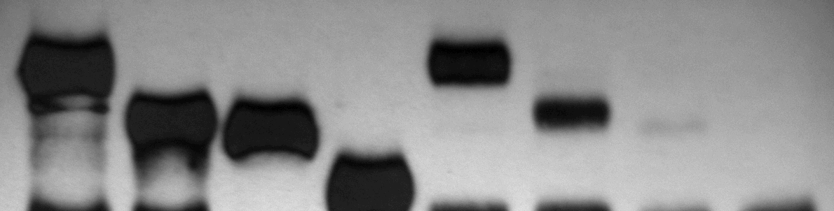
The C-terminal zinc finger domain is required for
the interaction with T-bet
1
BTB/POZ
PEST
ZF
706
Bcl6
130
520
681
Bcl6ΔBTB
Bcl6ΔZF
Bcl6ΔB/ZF
Co-IP
Input
IP: T-bet
Bcl6ΔBTB
Bcl6ΔB/ZF
Bcl6ΔBTB
Bcl6ΔB/ZF
Bcl6ΔZF
Bcl6ΔZF
Bcl6
Bcl6
IB:
αV5
1
2
3
4
5
6
7
8
Oestreich et al. Nat Immunol 2012

Slide 40
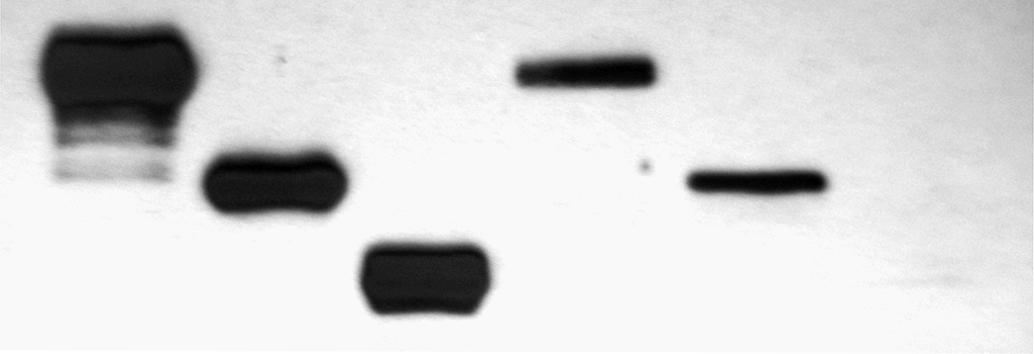
C-terminal domain of T-bet required for
its interaction with Bcl-6
T-box
(DNA-binding)
T-bet
T-betΔN
T-betΔC
Co-IP
Input
IP: Bcl6
T-betΔN
T-betΔC
T-betΔN
T-bet
T-bet
T-betΔC
IB:
αV5
1
2
3
4
5
6
Oestreich et al. Nat Immunol 2012

Slide 41
T-bet and Bcl-6 physically interact through the
C-terminal ZF domain of Bcl-6
1
BTB/POZ
PEST
ZF
706
Bcl6
130
520
681
Complex formation with T-bet
Bcl-6
T-bet

Slide 42
Model for differential targeting between loci
Locus X
Bcl-6
+1
Bcl-6
T-bet
Bcl-6
Bcl-6
T-bet
Locus Y
T-bet
+1

Slide 43
Effector T_{H}1 high IL-2

Slide 44
Effector T_{H}1 high IL-2

Slide 45
Effector T_{H}1 high IL-2

Slide 46
Effector T_{H}1 high IL-2

Slide 47
Model for differential targeting between loci
Locus X
Bcl-6
+1
Bcl-6
T-bet
Bcl-6
Bcl-6
T-bet
Locus Y
T-bet
+1

Slide 48
Model for differential targeting between loci
Bcl-6
Locus X
Bcl-6
+1
Bcl-6
Bcl-6
Bcl-6
T-bet
Bcl-6
Bcl-6
T-bet
Bcl-6
Locus Y
T-bet
+1

Slide 49
Are there conditions that naturally induce Bcl-6
expression in T_{H}1 cells?
T_{H}1
T_{FH}-like?
Bcl6
Bcl6
Bcl6
Bcl6
Bcl6
T-bet
T-bet
Bcl6
T-bet
T-bet
T-bet
Bcl6
Bcl6
T-bet
T-bet
Bcl6
Bcl6
Cxcr5
Cxcr5
Bcl6
Btla
Bcl6
Btla
Il6ra
Bcl6
Il6ra
Prdm1
T-bet
Prdm1
Bcl6
Ifng
T_{H}1 polarizing
conditions
Bcl6
Ifng
Bcl6
T-bet
T-bet
Bcl6
Bcl6
Bcl6
T-bet
T-bet
T-bet
Bcl6
T-bet
Bcl6
Bcl6
Bcl-6
Bcl-6

Slide 50
Are there conditions that naturally induce Bcl-6
expression in T_{H}1 cells?
IL-2 signaling?
T_{H}1
T_{FH}-like?
IL-2R
IL-2R
Bcl6
Bcl6
Bcl6
Bcl6
Bcl6
T-bet
T-bet
Bcl6
T-bet
T-bet
T-bet
Bcl6
Bcl6
T-bet
T-bet
Bcl6
Bcl6
Cxcr5
Cxcr5
Bcl6
Btla
Bcl6
Btla
Il6ra
Bcl6
Il6ra
Blimp1
T-bet
Blimp1
Bcl6
Ifng
T_{H}1 polarizing
conditions
Bcl6
Ifng
Bcl6
T-bet
T-bet
Bcl6
Bcl6
Bcl6
T-bet
T-bet
T-bet
Bcl6
T-bet
Bcl6
Bcl6
Bcl-6
Bcl-6

Slide 51
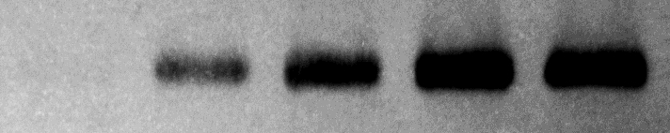


Bcl-6 expression in T_{H}1 cells is inhibited IL-2 signaling
Bcl6
HI IL-2
IL-2
LO IL-2
Bcl-6
Relative Expression
T-bet
GAPDH

Slide 52
T_{H}1-T_{FH}-like low IL-2
?

Slide 53
Expression of Blimp1 and Bcl-6 inversely correlate in T_{H}1 cells
Primary Th1 ChIP (α-Bcl-6)
Prdm1
(Blimp1)
HI IL-2
LO IL-2
Percent Input

Slide 54

Expression of Blimp1 and Bcl-6 inversely correlate in T_{H}1 cells
Primary Th1 ChIP (α-Bcl-6)
Primary WT T_{H}1 qRT-PCR
Prdm1
(Blimp1)
Prdm1
(Blimp1)
HI IL-2
HI IL-2
LO IL-2
LO IL-2
Percent Input
Relative Expression
IL-2
Bcl-6
Blimp-1
T-bet
GAPDH

Slide 55
T_{H}1-T_{FH}-like low IL-2
?
?
?

Slide 56
The expression of a subset of T_{FH}-signature genes are
enhanced in T_{H}1 cells maintained in low IL-2
Primary WT T_{H}1 qRT-PCR
Cxcr5
Il6ra
Btla
HI IL-2
LO IL-2
Relative Expression
Relative Expression
Relative Expression

Slide 57
T-bet and Bcl-6 complex formation generates a
regulatory switch enabling Th1/Tfh flexibility

Slide 58
Therapeutic Strategies-
Cytokine based immunotherapy

Slide 59
Factors influencing T helper cell differentiation
External cytokine environment
2. Internal transcriptional networks
3. Interactions between these factors

Slide 60
Factors influencing T helper cell differentiation
External cytokine environment
2. Internal transcriptional networks
3. Interactions between these factors
This complexity makes it an ideal problem to be solved
by computational modeling

Slide 61
How can computational modeling aid in our
understanding of T helper cell differentiation?

Slide 62
Specialized CD4⁺ T cell subtype flexibility
Current Opinion in Immunology Volume 24, Issue 3 2012 297 - 302

Slide 63



Acknowledgements
Oestreich Lab
Kaitlin Read, M.S. Chandra Baker
Paul McDonald, Ph.D. Ian Cooley
Ashlyn Anderson Emily Meeks
Josep Bassaganya-Riera, Ph.D.
Bassaganya-Riera Lab
UAB
Amy Weinmann, Ph.D.
University of Cal-Berkeley
Sarah Gilbertson

